Slide 1
Hierarichal Inheritance

Slide 2
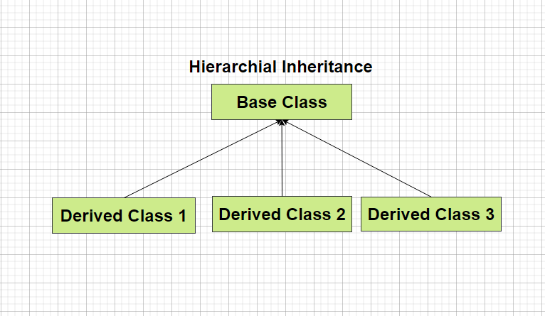
Hierarichal Inheritance
In Hierarichal Inheritance we have several classes that are derived from a common base class (or parent class).
Here in the diagram Class 1, Class 2 and Class 3 are derived from a common parent class called Base Class.

Slide 3
Diagramatic Representation of Hierarichal Inheritance

Slide 4
How to implement Hierarichal Inheritance in C++
In the example present in the left we have class A as a parent class and class B and class C that inherits some property of Class A.
While performing inheritance it is necessary to specify the access_specifier which can be public, private or protected.
class A {
// Body of Class A
}; // Base Class
class B : access_specifier A
{
// Body of Class B
}; // Derived Class
class C : access_specifier A
{
// Body of Class C
}; // Derived Class

Slide 5
Access Specifiers
In C++ we have basically three types of access specifiers :
Public : Here members of the class are accessible outside the class as well.
Private : Here members of the class are not accessible outside the class.
Protected : Here the members cannot be accessed outside the class, but can be accessed in inherited classes.

Slide 6
Example of Inheritance
class Car {
public:
int wheels = 4;
void show() {
cout << "No of wheels : "<<wheels ;
}
};
class Audi: public Vehicle {
public:
string brand = "Audi";
string model = “A6”;
};
class Volkswagen: public Car {
public:
string brand = "Volkswagen";
string model = “Beetle”;
};
class Honda: public Car {
public:
string brand = "Honda";
string model = “City”;
};

